Slide 1
Machine Learning –Understanding logistic regression
Made by – Anushree Asthana

Slide 2
Table of contents
01
02
03
04
Introduction
What it is and how it works?
Classification vs. Regression
What are the key differences?
Understanding the Sigmoid Function
Important part of logistic regression.
The model and its implementation.
With code and algorithm

Slide 3
01
Introduction
What is logistic regression?

Slide 4
Introduction
Logistic regression is a fundamental tool in machine learning used for classification tasks. Unlike linear regression, which predicts continuous values, logistic regression excels at categorizing data points into distinct classes. Imagine sorting emails into spam or inbox, classifying images as cats or dogs – that's where logistic regression shines!

Slide 5

Purpose
When to Use Logistic Regression?
Binary Classification: Perfect for scenarios with two distinct classes.
Linear Relationship: Works best when features (independent variables) have a linear relationship with the target variable (dependent variable).
Clear Features: Requires well-defined and interpretable features for optimal performance.

Slide 6
Features of Logistic regression:
Binary Classification
Linear Relationship
Probability Output
It's primarily designed for problems with two outcome categories.
It assumes a linear relationship between the features and the target.
uses sigmoid function to transform the model's output into a probability between 0 and 1
Interpretability
Efficiency
Easy to use
Unlike some complex models, logistic regression allows you to understand how each feature influences the predictions
Training and making predictions with logistic regression are computationally efficient
It is easy to use and produce a code for.

Slide 7
Classification vs Regression

Slide 8

Lets : Define classification and regression tasks with examples and highlight that logistic regression falls under classification for predicting discrete categories.

Slide 9
Classification vs regression
Classification:
Goal: Assigns data points to specific categories.
Output: Discrete labels representing the class.
Examples:
Spam filtering: Classifying emails as spam or not spam (binary classification).
Image recognition: Categorizing images as cats, dogs, or other objects (multi-class classification).
Medical diagnosis: Predicting whether a patient has a specific disease (e.g., cancer: yes/no).
Regression:
Goal: Predicts continuous values.
Output: Numerical value representing a quantity.
Examples:
House price prediction: Estimating the selling price of a house based on factors like size and location.
Weather forecasting: Predicting the temperature or rainfall for a specific location.
Stock price prediction: Forecasting the future value of a stock based on historical data.

Slide 10
Here’s how logistic regression is classification:
Logistic regression falls under the umbrella of classification. It excels at tasks where the target variable has discrete categories (like spam/not spam) instead of continuous values (like house price). Logistic regression uses a mathematical model to analyze the features (independent variables) and estimate the probability of an instance belonging to a particular class.

Slide 11
Understanding the sigmoid function
The basis of logistic regression.

Slide 12
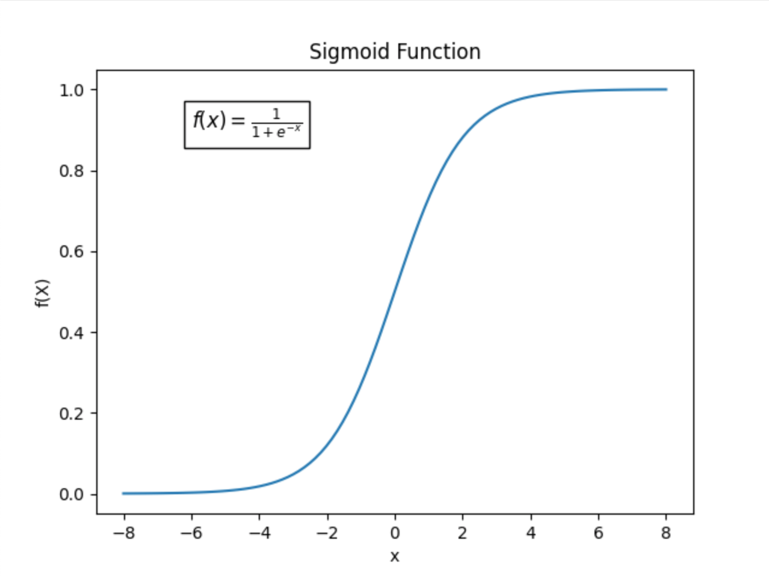
The sigmoid function:
The sigmoid function in logistic regression acts like a gatekeeper, transforming the model's linear output into a probability between 0 and 1.
Values closer to 0 in the sigmoid function indicate a lower probability of belonging to class 1.
Values closer to 1 suggest a higher probability of belonging to class 1.

Slide 13
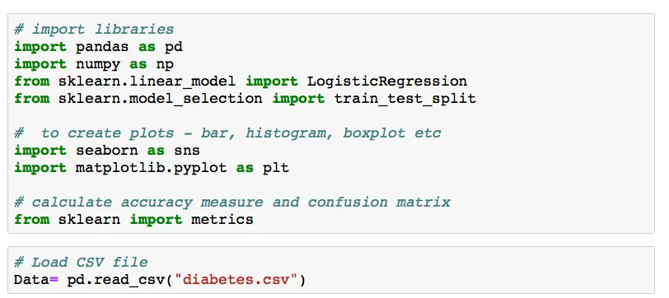
Implementation of logistic regression:
Example: The classification goal is to predict whether or not the patients in the dataset have diabetes or not. Lets first load the data and install dependencies.

Slide 14
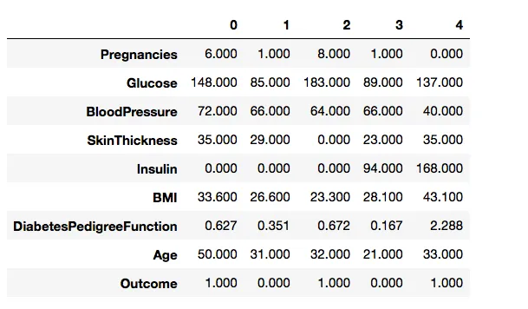
I used Data.head().transpose() function to look at the top 5 rows of a data frame. This function is useful for quickly checking if the datasets have right type of data in it.

Slide 15
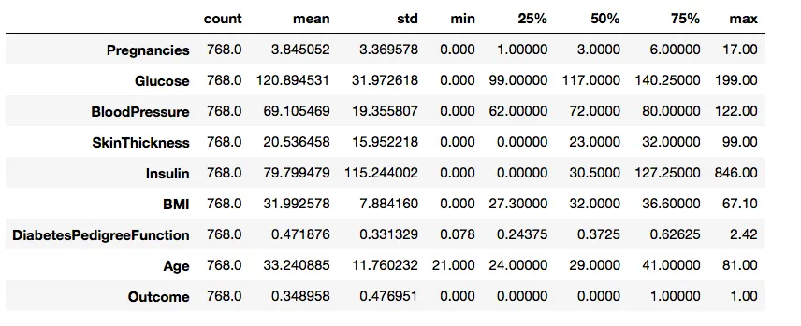
To understand the distribution of the data I will use describe function from pandas. Data.describe () function will allow to analyse the distribution of the features.

Slide 16
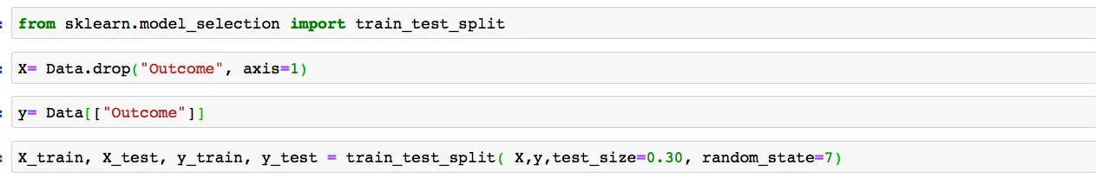
We have split the dataset in a 70–30 ratio. We will use the training data frames to build our Logistic Regression model and test to compare its performance.
To apply Logistic Regression model to classify we will call the model using LogisticRegression () function. First, we will train our dataset in Logistic Regression model on (X_train, y_train) and we will use (X_test, y_test) to evaluate the model generated. We will build the Logistic Regression model and predict for X_test and compare prediction to the y_test.

Slide 17
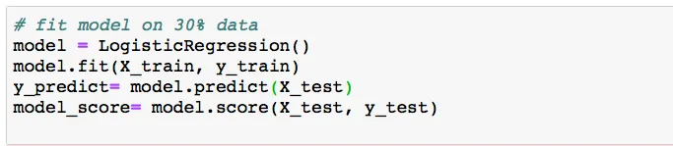
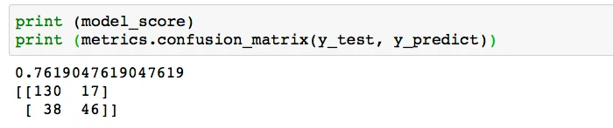
We get a 76% precise classifier using Logistic Regression. To understand our evaluation in more depth we used confusion matrix metric. Confusion matrix helps us to understand the two types of error. Type I, also known as false positive and type II, also known as a false negative. Depending on the different domain these types are useful during the data analysis process.

Slide 18
Thanks!

